Slide 1
Credit risk-based pricing
Roman Ivanov, PMP, FRM, CFA
Lead VP, Independent Model Review, HSBC

Slide 2
Credit risk-based pricing
Content
PD, LGD and EAD model process building: overview.
PD model VS Credit Rating System performance assessment:
PD model accuracy and discriminatory power.
Credit Grade System development.
Credit Rating System performance assessment.
Credit risk-based pricing. Large homogeneous portfolio.
Price of the expected credit risk.
Costs of economic capital at credit risk.
Risk-adjusted return on capital (RAROC).
Conclusion: Model Validation.

Slide 3
1. PD, LGD and EAD model process building: overview

Slide 4
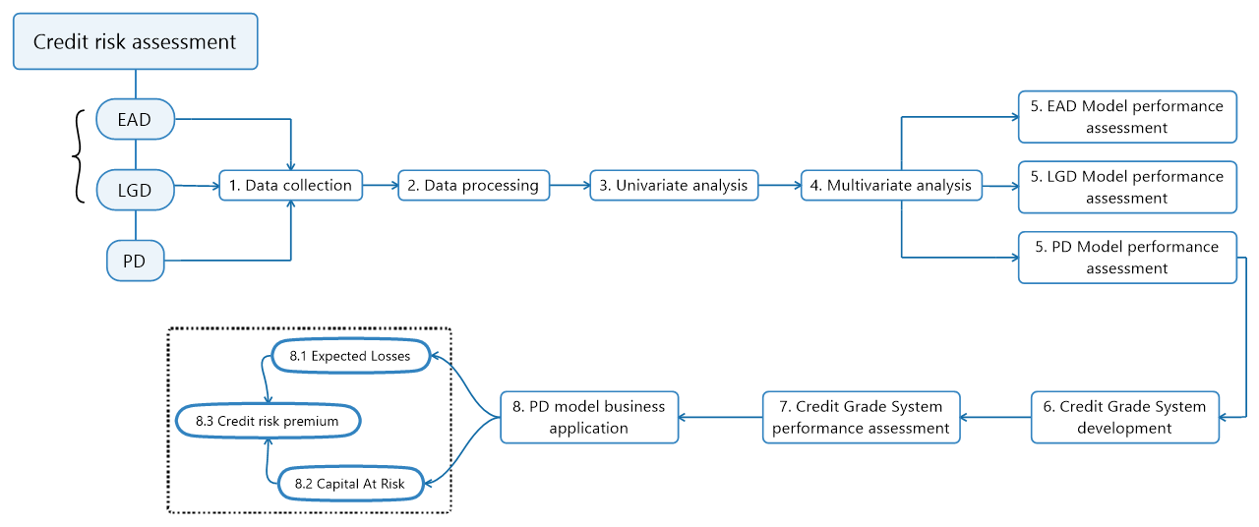
Credit risk-based pricing PD, LGD and EAD model building: overview

Slide 5
2. PD model VS Credit Rating System performance assessment

Slide 6
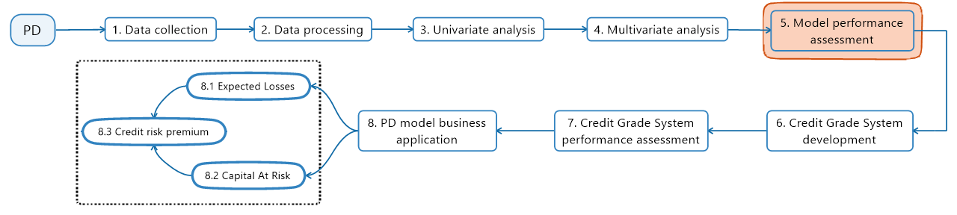
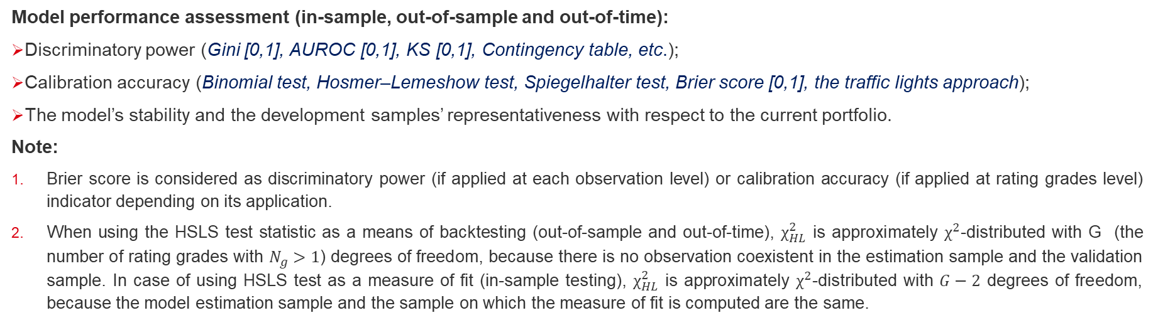
Credit risk-based pricing PD model VS Credit Rating System performance assessment
Model performance assessment (in-sample, out-of-sample and out-of-time):
Discriminatory power (Gini [0,1], AUROC [0,1], KS [0,1], Contingency table, etc.);
Calibration accuracy (Binomial test, Hosmer–Lemeshow test, Spiegelhalter test, Brier score [0,1], the traffic lights approach);
The model’s stability and the development samples’ representativeness with respect to the current portfolio.
Note:
Brier score is considered as discriminatory power (if applied at each observation level) or calibration accuracy (if applied at rating grades level) indicator depending on its application.
When using the HSLS test statistic as a means of backtesting (out-of-sample and out-of-time), $χ_{HL}^{2}$ is approximately $χ^{2}$-distributed with G (the number of rating grades with $N_{g}>1$) degrees of freedom, because there is no observation coexistent in the estimation sample and the validation sample. In case of using HSLS test as a measure of fit (in-sample testing), $χ_{HL}^{2}$ is approximately $χ^{2}$-distributed with $G−2$ degrees of freedom, because the model estimation sample and the sample on which the measure of fit is computed are the same.

Slide 7
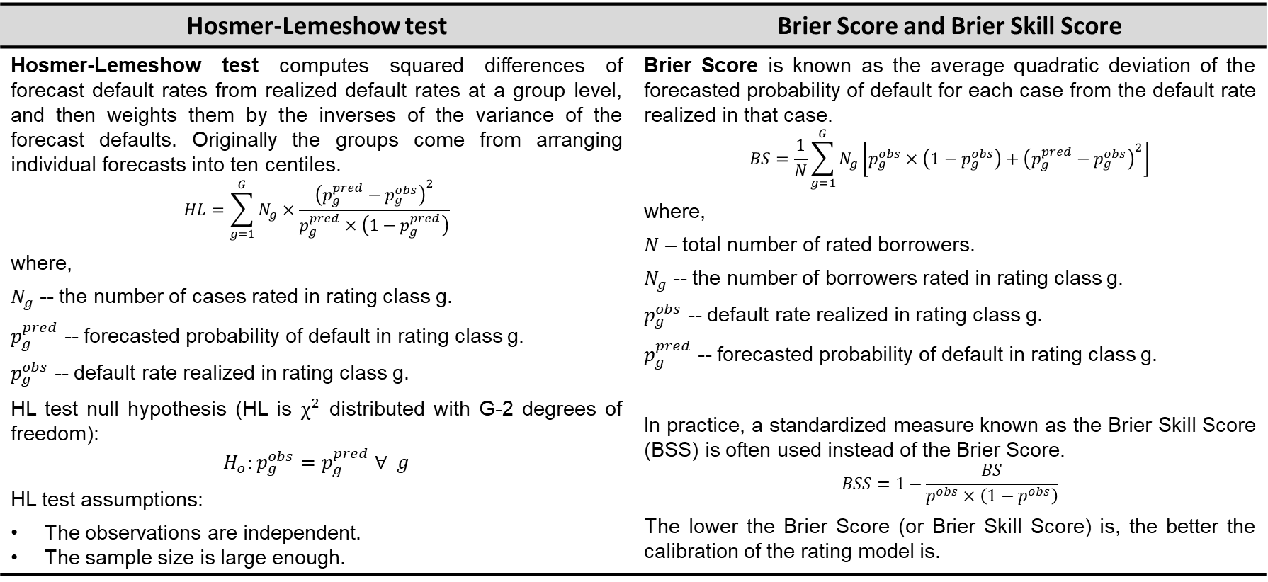
Credit risk-based pricing PD model VS Credit Rating System performance assessment
Calibration accuracy
Hosmer-Lemeshow test | Brier Score and Brier Skill Score
Hosmer-Lemeshow test computes squared differences of forecast default rates from realized default rates at a group level, and then weights them by the inverses of the variance of the forecast defaults. Originally the groups come from arranging individual forecasts into ten centiles. $$HL=\sum_{g=1}^{G}{N_{g}×\frac{{\left(p_{g}^{pred}−p_{g}^{obs}\right)}^{2}}{p_{g}^{pred}×\left(1−p_{g}^{pred}\right)}}$$ where, $N_{g}$ -- the number of cases rated in rating class g. $p_{g}^{pred}$ -- forecasted probability of default in rating class g. $p_{g}^{obs}$ -- default rate realized in rating class g. HL test null hypothesis (HL is $χ^{2}$ distributed with G-2 degrees of freedom): $$H_{o}:p_{g}^{obs}=p_{g}^{pred} ∀ g$$ HL test assumptions: The observations are independent. The sample size is large enough. | Brier Score is known as the average quadratic deviation of the forecasted probability of default for each case from the default rate realized in that case. $$BS=\frac{1}{N}\sum_{g=1}^{G}{N_{g}\left[p_{g}^{obs}×\left(1−p_{g}^{obs}\right)+{\left(p_{g}^{pred}−p_{g}^{obs}\right)}^{2}\right]}$$ where, $N$ – total number of rated borrowers. $N_{g}$ -- the number of borrowers rated in rating class g. $p_{g}^{obs}$ -- default rate realized in rating class g. $p_{g}^{pred}$ -- forecasted probability of default in rating class g. In practice, a standardized measure known as the Brier Skill Score (BSS) is often used instead of the Brier Score. $$BSS=1−\frac{BS}{p^{obs}×\left(1−p^{obs}\right)}$$ The lower the Brier Score (or Brier Skill Score) is, the better the calibration of the rating model is.

Slide 8
Credit risk-based pricing PD model VS Credit Rating System performance assessment
Case study 1. PD model performance: Calibration accuracy.
Description: The risk management team of the bank Alpha has recently developed logistic regression based PD model to use in retail lending business. John Smith, junior model developer, has conducted PD model performance assessment and is not 100% sure about final model selection.
Task: As a model risk manager, please, replicate PD model calibration accuracy assessment results and make conclusion about model performance.
Solution:
Rating class | Number of Goods | Number of Bads | Total number | Realized default rate | Probability of default | HL stat | Brier Score
1 | 1391 | 54 | 1445 | 3.74% | 3.82% | 0.03 | 51.98
2 | 1329 | 116 | 1445 | 8.03% | 7.71% | 0.21 | 106.70
3 | 1315 | 131 | 1446 | 9.06% | 10.29% | 2.38 | 119.35
4 | 1229 | 216 | 1445 | 14.95% | 13.29% | 3.44 | 184.11
5 | 1197 | 249 | 1446 | 17.22% | 17.35% | 0.02 | 206.13
6 | 1094 | 351 | 1445 | 24.29% | 23.40% | 0.64 | 265.85
7 | 993 | 452 | 1445 | 31.28% | 31.06% | 0.03 | 310.62
8 | 867 | 579 | 1446 | 40.04% | 40.01% | 0.00 | 347.16
9 | 693 | 752 | 1445 | 52.04% | 50.42% | 1.52 | 361.03
10 | 487 | 959 | 1446 | 66.32% | 66.13% | 0.02 | 322.99
All classes | 10595 | 3859 | 14454 | 26.70% | 26.35% | 8.30 | 0.1575
 |  |  |  |  |  | X-squared | BS
 |  |  |  |  |  | 40.51% | 0.1954
 |  |  |  |  |  | P value | BSS

Slide 9
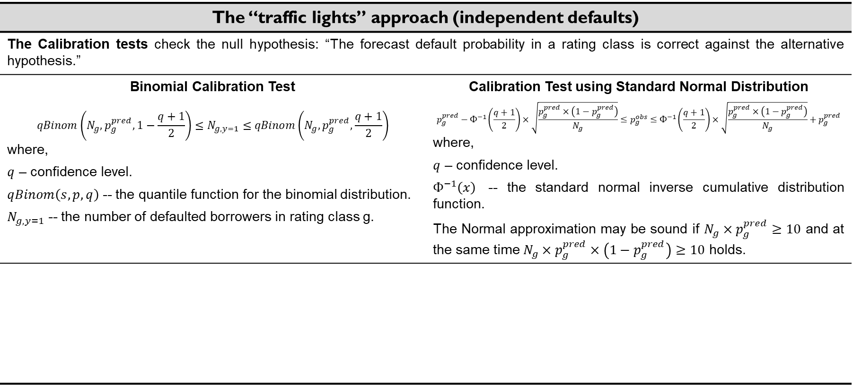
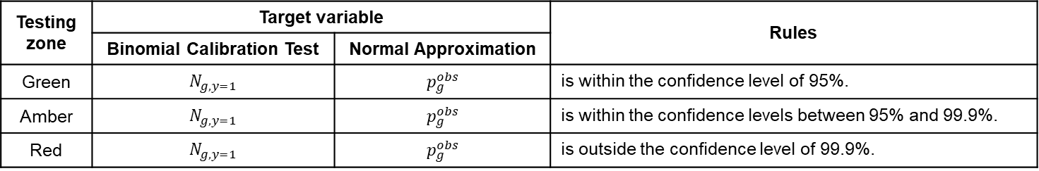
Credit risk-based pricing PD model VS Credit Rating System performance assessment
Calibration accuracy (continue)
The “traffic lights” approach (independent defaults)
The Calibration tests check the null hypothesis: “The forecast default probability in a rating class is correct against the alternative hypothesis.”
Binomial Calibration Test $$qBinom\left(N_{g},p_{g}^{pred},1−\frac{q+1}{2}\right)≤N_{g,y=1}≤qBinom\left(N_{g},p_{g}^{pred},\frac{q+1}{2}\right)$$ where, $q$ – confidence level. $qBinom\left(s,p,q\right)$ -- the quantile function for the binomial distribution. $N_{g,y=1}$ -- the number of defaulted borrowers in rating class g. | Calibration Test using Standard Normal Distribution $$p_{g}^{pred}−Ф^{−1}\left(\frac{q+1}{2}\right)×\sqrt{\frac{p_{g}^{pred}×\left(1−p_{g}^{pred}\right)}{N_{g}}}≤p_{g}^{obs}≤Ф^{−1}\left(\frac{q+1}{2}\right)×\sqrt{\frac{p_{g}^{pred}×\left(1−p_{g}^{pred}\right)}{N_{g}}}+p_{g}^{pred}$$ where, $q$ – confidence level. $Ф^{−1}\left(x\right)$ -- the standard normal inverse cumulative distribution function. The Normal approximation may be sound if $N_{g}×p_{g}^{pred}≥10$ and at the same time $N_{g}×p_{g}^{pred}×\left(1−p_{g}^{pred}\right)≥10$ holds.
Testing zone | Target variable |  | Rules
 | Binomial Calibration Test | Normal Approximation
Green | $$N_{g,y=1}$$ | $$p_{g}^{obs}$$ | is within the confidence level of 95%.
Amber | $$N_{g,y=1}$$ | $$p_{g}^{obs}$$ | is within the confidence levels between 95% and 99.9%.
Red | $$N_{g,y=1}$$ | $$p_{g}^{obs}$$ | is outside the confidence level of 99.9%.

Slide 10
Credit risk-based pricing PD model VS Credit Rating System performance assessment
Case study 2. PD model performance: Calibration accuracy.
Description: The risk management team of the bank Alpha has recently developed logistic regression based PD model to use in retail lending business. John Smith, junior model developer, has assessed PD model performance and proposed to approve.
Task: As a model risk manager, please, assess the model calibration accuracy thresholds for each rating class and make conclusion about model performance. Assume that the defaults are independent.
Solution:

Slide 11
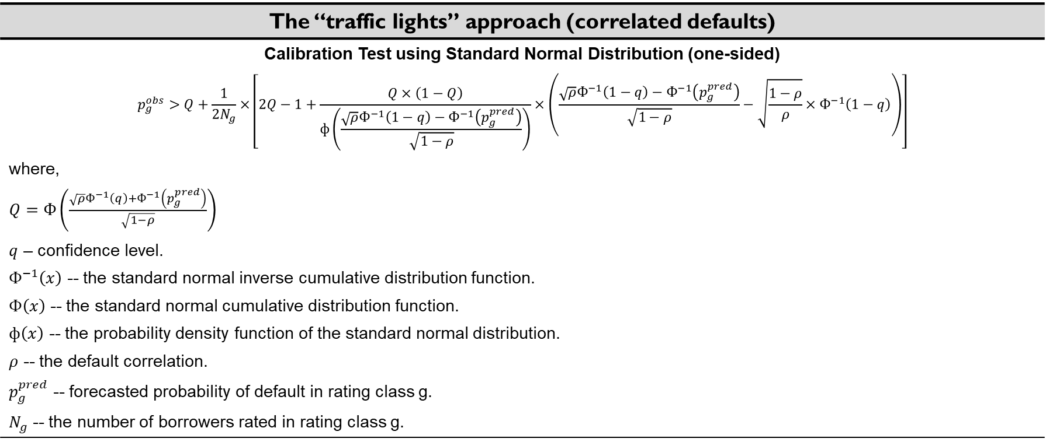
Credit risk-based pricing PD model VS Credit Rating System performance assessment
Calibration accuracy (continue)
The “traffic lights” approach (correlated defaults)
Calibration Test using Standard Normal Distribution (one-sided) $$p_{g}^{obs}>Q+\frac{1}{{2N}_{g}}×\left[2Q−1+\frac{Q×\left(1−Q\right)}{ф\left(\frac{\sqrt{ρ}Ф^{−1}\left(1−q\right)−Ф^{−1}\left(p_{g}^{pred}\right)}{\sqrt{1−ρ}}\right)}×\left(\frac{\sqrt{ρ}Ф^{−1}\left(1−q\right)−Ф^{−1}\left(p_{g}^{pred}\right)}{\sqrt{1−ρ}}−\sqrt{\frac{1−ρ}{ρ}}×Ф^{−1}\left(1−q\right)\right)\right]$$ where, $Q=Ф\left(\frac{\sqrt{ρ}Ф^{−1}\left(q\right)+Ф^{−1}\left(p_{g}^{pred}\right)}{\sqrt{1−ρ}}\right)$ $q$ – confidence level. $Ф^{−1}\left(x\right)$ -- the standard normal inverse cumulative distribution function. $Ф\left(x\right)$ -- the standard normal cumulative distribution function. $ф\left(x\right)$ -- the probability density function of the standard normal distribution. $ρ$ -- the default correlation. $p_{g}^{pred}$ -- forecasted probability of default in rating class g. $N_{g}$ -- the number of borrowers rated in rating class g.

Slide 12
Credit risk-based pricing PD model VS Credit Rating System performance assessment
Case study 3. PD model performance: Calibration accuracy.
Description: The risk management team of the bank Alpha has recently developed logistic regression based PD model to use in retail lending business. John Smith, junior model developer, has assessed PD model performance and proposed to approve. Just after model proposal to approve John Smith noted that there could be a lot of borrowers related to around the same industry. The updates have been sent to Independent Model Review department.
Task: As a model risk manager, please, re-assess the model accuracy thresholds for each rating class given information about potential industry concertation in credit portfolio, make conclusion about model performance. Tip: Assume correlated defaults.
Solution:

Slide 13
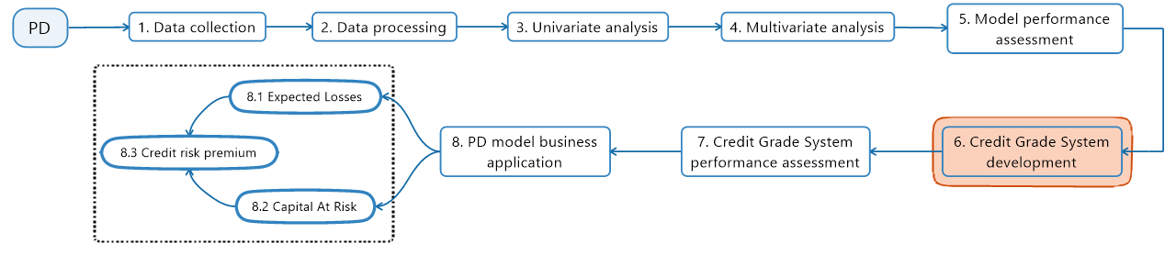
Credit risk-based pricing PD model VS Credit Rating System performance assessment
Credit Grade System development:
Define total number of non-defaulted credit grades (min 7 non-defaulted grades, Basel III, §171);
Define PD bounds (minimum and maximum) for each credit grade avoiding excessive concentrations in single rating classes (A bank must have a meaningful distribution of exposures across grades with no excessive concentrations…, Basel II, §404);
Assign the obligors to internal rating grades (Borrowers are assigned rating grades and average PD of each grade is estimated. The average PD-estimate for a grade is then used as the PD for all borrowers within the grade.) – “machine (or model) rating”;
Adjust “machine (or model) rating” by overriding (upgrading or downgrading) the rule based rating – final rating (Overrides should be of exceptional character and must be well documented, founded and approved by a senior management board. Basel II requires separate monitoring of overrides. Basel II, §428).

Slide 14
Credit risk-based pricing PD model VS Credit Rating System performance assessment
The borrowers are mapped to a set of risk grades based on PD boundaries. The default probability of a rating category can then be estimated in following ways:
Using the historical default rate experience of obligors in a given rating grade.
Using published by rating agencies default rates (in case of mapping into categories of rating agencies).
Using the average of the individual default probability estimates of obligors in the grade (e.g., estimates obtained through PD model).
Grade | PD min
1 | 0.0000%
2 | 0.0500%
3 | 0.0800%
4 | 0.1200%
5 | 0.5000%
6 | 2.5000%
7 | 15.0000%
Grade | PD min
1 | 0.0000%
2 | 0.9017%
3 | 2.0477%
4 | 3.0713%
5 | 4.0132%
6 | 7.7168%
7 | 12.7089%
8 | 20.2227%
9 | 40.0826%
10 | 87.5956%
Grade | PD min
1 | 0.0000%
2 | 0.0290%
3 | 0.0540%
4 | 0.0960%
5 | 0.1700%
6 | 0.2860%
7 | 0.4840%
8 | 0.7410%
9 | 1.0230%
10 | 1.4080%
11 | 1.9280%
12 | 2.6210%
13 | 3.5800%
14 | 4.9150%
15 | 6.7184%
16 | 8.8600%
17 | 11.4030%
18 | 15.0000%
19 | 22.0000%
20 | 30.0000%

Slide 15
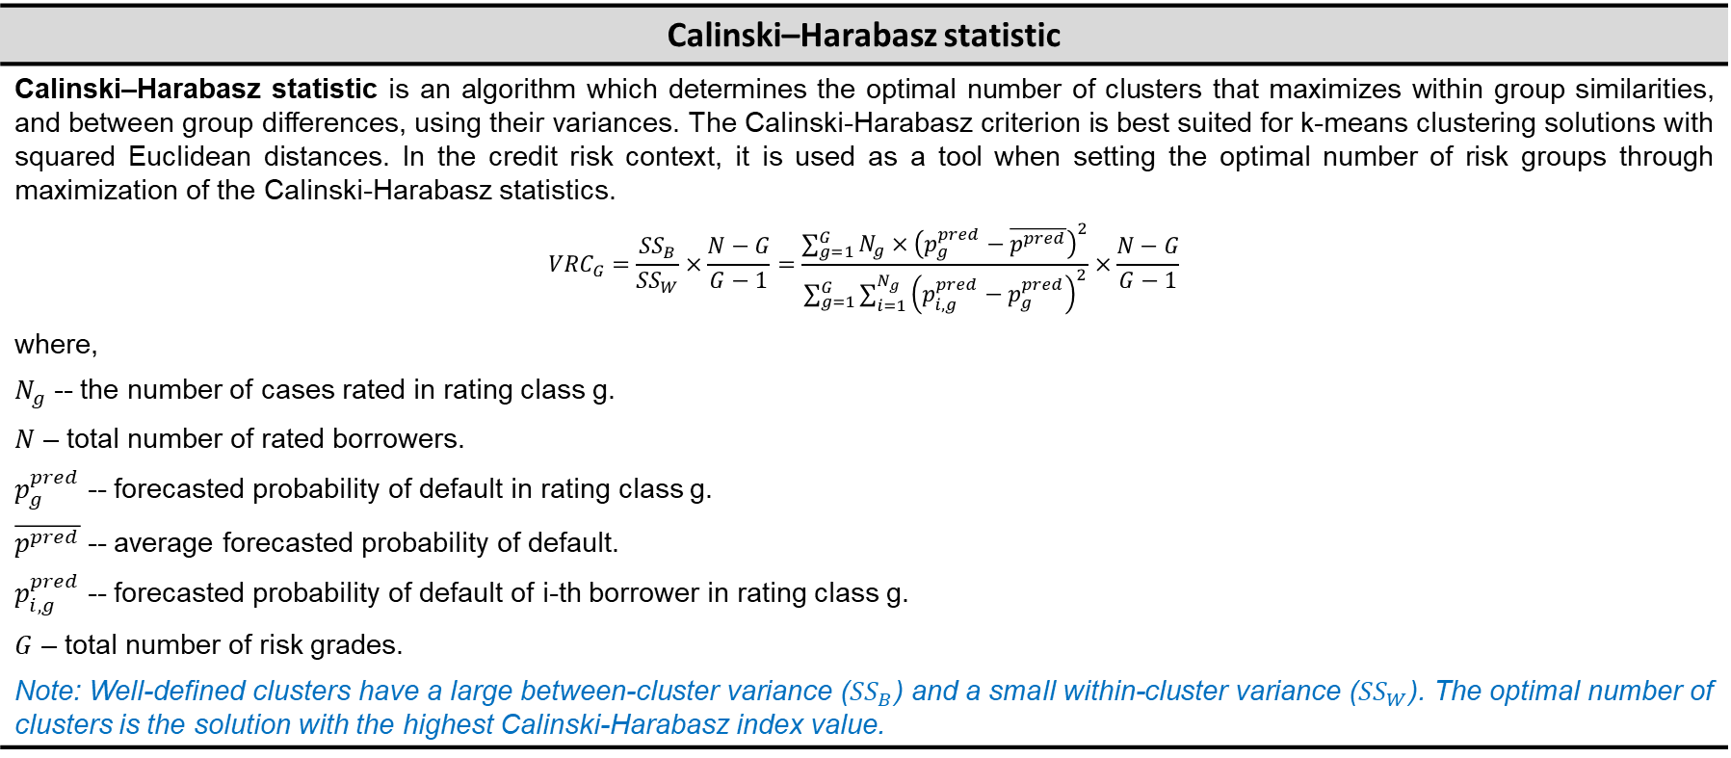
Credit risk-based pricing PD model VS Credit Rating System performance assessment
Clustering evaluation
Calinski–Harabasz statistic
Calinski–Harabasz statistic is an algorithm which determines the optimal number of clusters that maximizes within group similarities, and between group differences, using their variances. The Calinski-Harabasz criterion is best suited for k-means clustering solutions with squared Euclidean distances. In the credit risk context, it is used as a tool when setting the optimal number of risk groups through maximization of the Calinski-Harabasz statistics. $${VRC}_{G}=\frac{{SS}_{B}}{{SS}_{W}}×\frac{N−G}{G−1}=\frac{\sum_{g=1}^{G}{N_{g}×{\left(p_{g}^{pred}−\overline{p^{pred}}\right)}^{2}}}{\sum_{g=1}^{G}{\sum_{i=1}^{N_{g}}{{\left(p_{i,g}^{pred}−p_{g}^{pred}\right)}^{2}}}}×\frac{N−G}{G−1}$$ where, $N_{g}$ -- the number of cases rated in rating class g. $N$ – total number of rated borrowers. $p_{g}^{pred}$ -- forecasted probability of default in rating class g. $\overline{p^{pred}}$ -- average forecasted probability of default. $p_{i,g}^{pred}$ -- forecasted probability of default of i-th borrower in rating class g. $G$ – total number of risk grades. Note: Well-defined clusters have a large between-cluster variance (${SS}_{B}$) and a small within-cluster variance (${SS}_{W}$). The optimal number of clusters is the solution with the highest Calinski-Harabasz index value.

Slide 16
Credit risk-based pricing PD model VS Credit Rating System performance assessment
Case study 4. Credit grade system development: Optimal number of Credit grades.
Description: The risk management team of the bank Alpha has recently developed logistic regression based PD model to use in retail lending business. The model performance has been assessed and found to be within the acceptable bounds. As a result, John Smith, junior model developer, has recently received the model sponsor’s approval. Given the PD model should be easy to apply and intuitive for credit analyst, John is going to develop a credit grade system taking into account Basel requirements and best practice. Finally, John prepared three candidate credit grade systems to submit for independent model review.
Task: As a model risk manager, please, replicate John’s analysis, make and justify conclusion about the most sound credit grade system based on CH statistics.
Solution:
Rating_scale_3
Rating class | PD_min | CH Index
1 | 0.0000% | 5 780.17
2 | 0.0290%
3 | 0.0540%
4 | 0.0960%
5 | 0.1700%
6 | 0.2860%
7 | 0.4840%
8 | 0.7410%
9 | 1.0230%
10 | 1.4080%
11 | 1.9280%
12 | 2.6210%
13 | 3.5800%
14 | 4.9150%
15 | 6.7184%
16 | 8.8600%
17 | 11.4030%
18 | 15.0000%
19 | 22.0000%
20 | 30.0000%
Rating_scale_1
Rating class | PD_min | CH Index
1 | 0.0000% | 8 503.03
2 | 0.0500%
3 | 0.0800%
4 | 0.1200%
5 | 0.5000%
6 | 2.5000%
7 | 15.0000%
Rating_scale_2
Rating class | PD_min | CH Index
1 | 0.0000% | 17 118.92
2 | 0.9017%
3 | 2.0477%
4 | 3.0713%
5 | 4.0132%
6 | 7.7168%
7 | 12.7089%
8 | 20.2227%
9 | 40.0826%
10 | 87.5956%

Slide 17
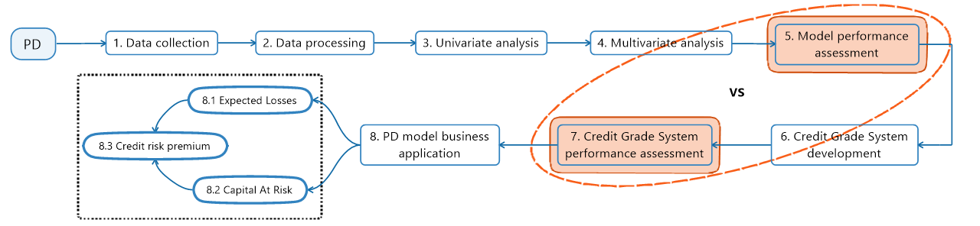
Credit risk-based pricing PD model VS Credit Rating System performance assessment
The key reasons to compare PD model and Credit Rating System model performance:
The grading structure and the distribution of grade boundaries affect:
the discriminatory power and calibration accuracy;
the credit risk premium;
the capital requirements.
To assess the pros and cons of different grading systems from performance and economic consequences perspective.
If Credit Rating System is already in place, the performance is assessed to find out whether its quality is (still) adequate.

Slide 18
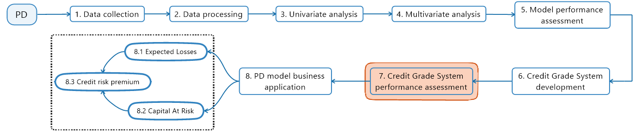
Credit risk-based pricing PD model VS Credit Rating System performance assessment
Credit Rating System performance assessment:
Discriminatory power (Gini [0,1], AUROC [0,1], KS [0,1], etc.) – How well does a rating system rank borrowers according to their true probability of default (PD)?
Calibration accuracy (Binomial test, Hosmer–Lemeshow test, Spiegelhalter test, Brier score [0,1], the traffic lights approach) – How well do estimated PDs match true PDs?;
Override rate;
Multiyear cumulative PDs (out-of-time test);
Stability of the ratings – Rating Migration (out-of-time test). Based on Cantor and Mann (2003) research about the stability of Moody’s rating system, it can be considered 25% or fewer one-notch ratings change as an upper threshold for a (presumably) very stable rating system and twice that (50%) as a threshold below which stability is considered poor.
Compare two different Credit Rating Systems (for example, Redelmeier test).

Slide 19
Credit risk-based pricing PD model VS Credit Rating System performance assessment
Case study 5. Credit Rating System performance assessment.
Description: The risk management team of the bank Alpha has just built three candidate credit grade systems based on approved retailed PD model. John Smith, junior model developer, conducted the assessment of the candidate credit grade systems with CH statistics – the optimal number of credit grades analysis. Given the grading structure and the distribution of grade boundaries affect discriminatory power and calibration accuracy, Model risk manager has just informed John about insufficient performance assessment of the candidate credit grade systems.
Task: Help John by conducting the performance assessment of the candidate credit grade systems. Make conclusion about the best credit grade system based on performance.
Solution:
Credit Rating System | Model performance
 | AUROC | Gini AR | HSLS test stat | HSLS p-value
7 grades | 0.6828 | 0.37 | 4.55 | 3.29%
10 grades | 0.7633 | 0.53 | 4.80 | 56.96%
20 grades | 0.7528 | 0.51 | 14.13 | 7.83%
PD model | 0.7790 | 0.56 | 8.30 | 40.51%
Note: The maximum attainable accuracy depends on the portfolio structure, in particular on the heterogeneity of a portfolio with respect to default probabilities.

Slide 20
Credit risk-based pricing PD model VS Credit Rating System performance assessment
Economic consequences of the Credit Rating System design
Credit Rating System and Capital requirements
The impact on capital requirements reflects the pros and cons of different grading systems. The capital requirement function is concave as a function of the PD. This implies that capital requirements will reduce, if the fineness of the grading structure increases. The capital requirements are affected by: The number of grades. A system with many grades exploits the capital function concavity better than a system with few. The distribution of grade boundaries. To take advantage of the concavity effect, the grading system (the grade boundaries) should be optimal from capital requirements perspective. The distribution of borrowers across PDs. Rating grades should be finer over PD regions with many borrowers.

Slide 21
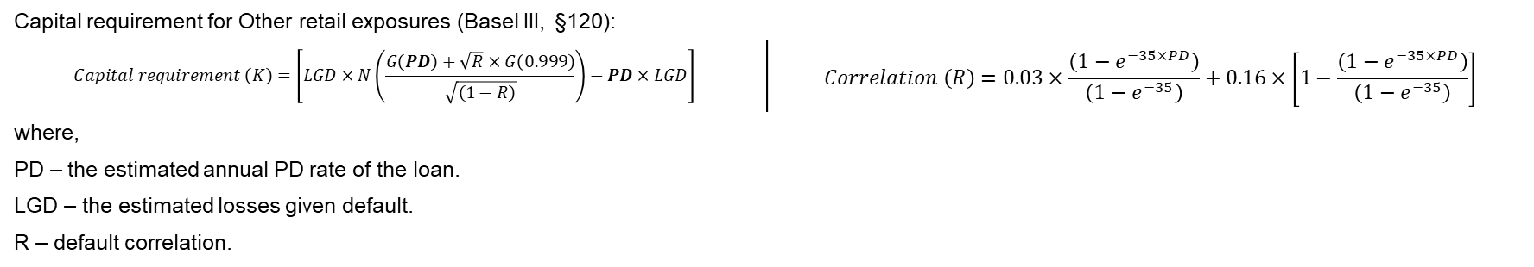
Credit risk-based pricing PD model VS Credit Rating System performance assessment
Case study 6. Credit Rating System capital impact assessment.
Description: The model development team of the bank Alpha has assessed the candidate credit grade systems in terms of discriminatory power and calibration accuracy, and the optimal number of credit grades. However, the economical effect of the proposed credit grading systems is still unknow. Given the credit grading system will impact the capital requirements, Model risk manager has requested John Smith, junior model developer, to provide capital requirements impact analysis of the credit rating systems and make the final model selection.
Task: The model development team has received request while John is on core leave. The Lead of model development team allocated the capital requirements impact task to the colleague of John. Assuming that the credit grade system is built for Other retail exposures conduct capital requirements impact analysis of the credit rating systems and make the final model selection.
Solution:
Capital requirement for Other retail exposures (Basel III, §120):
$$Capital requirement \left(K\right)=\left[LGD×N\left(\frac{G\left(PD\right)+\sqrt{R}×G\left(0.999\right)}{\sqrt{\left(1−R\right)}}\right)−PD×LGD\right]$$ | $$Correlation \left(R\right)=0.03×\frac{\left(1−e^{−35×PD}\right)}{\left(1−e^{−35}\right)}+0.16×\left[1−\frac{\left(1−e^{−35×PD}\right)}{\left(1−e^{−35}\right)}\right]$$
where, PD – the estimated annual PD rate of the loan. LGD – the estimated losses given default. R – default correlation.
Credit Rating System | Model performance |  |  |  | CH Index | Economic capital, EC
 | AUROC | Gini AR | HSLS test stat | HSLS p-value
7 grades | 0.6828 | 0.37 | 4.55 | 3.29% | 8 503.03 | 2 589.24
10 grades | 0.7633 | 0.53 | 4.80 | 56.96% | 17 118.92 | 2 449.86
20 grades | 0.7528 | 0.51 | 14.13 | 7.83% | 5 780.17 | 2 471.66
PD model | 0.7790 | 0.56 | 8.30 | 40.51% | n/a | n/a

Slide 22
3. Credit risk-based pricing. Large homogeneous portfolio

Slide 23
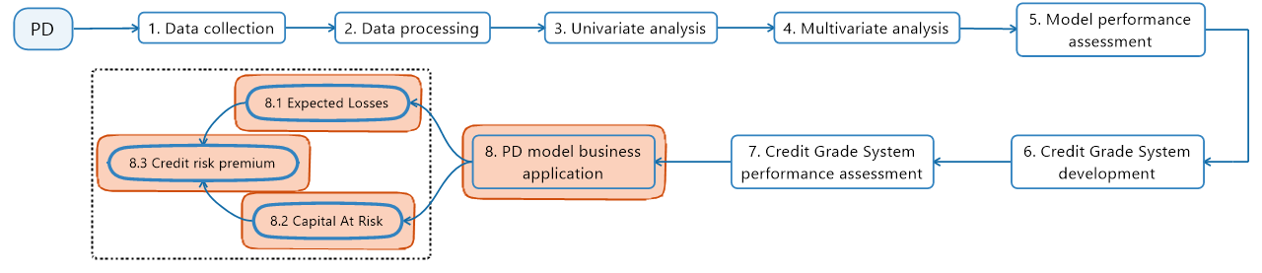
Credit risk-based pricing Credit risk-based pricing. Large homogeneous portfolio
Large homogeneous portfolio (LHP)
The credit risk pricing business application is based on the LHP assumptions:
Assumption 1: Credit portfolio contains infinitely many credits.
Assumption 2: The borrowers in the portfolio have the same or similar credit ratings. The default probability of all borrowers in the portfolio is the same.
Assumption 3: The credits have the same recovery rate (1-LGD).
Assumption 4: The borrowers in the portfolio belong to the same sector – the borrowers have the same correlation of default.
Assumption 5: The borrowers in the portfolio has the same exposure – no single name concentration.

Slide 24
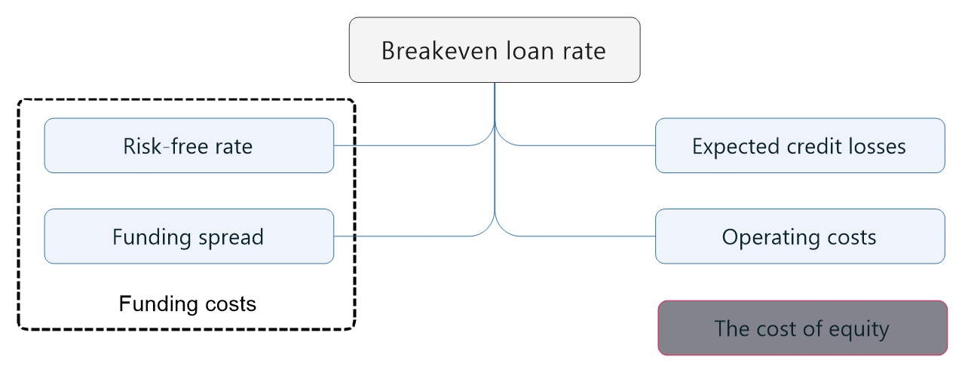
Credit risk-based pricing Credit risk-based pricing. Large homogeneous portfolio
Loan rate structure: Breakeven loan rate
Price-setting bank | Price-taking bank
The price of the loan should be set in such a way that it covers at least its production costs: funding costs, operating cists and expected credit losses. The loan rate could include required rate of return (the cost of equity). Note: Bank is only free to set the prices of its loans (i.e. to act as a price setter) when it operates in a sufficiently inelastic market, where it enjoys an adequate market power. | Bank is forced to accept the prices imposed upon it by the market. Credit risk measurement models are used to identify (and refuse) loans for which the market rate is too low.

Slide 25
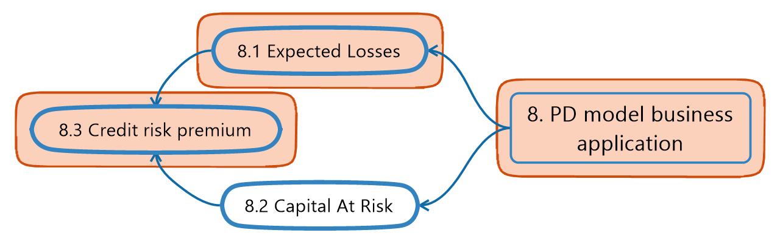
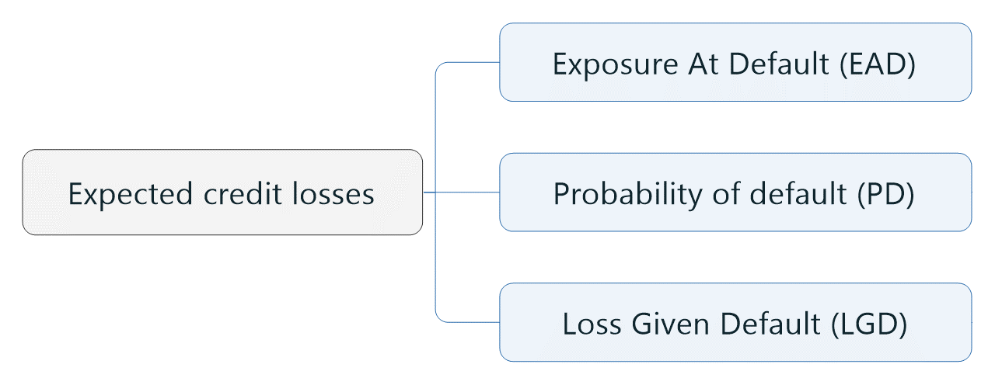
Credit risk-based pricing Credit risk-based pricing. Large homogeneous portfolio
Price of the expected credit risk
Price of the expected credit risk is a function of two factors:
The probability of default by the borrower (PD).
PD is summarized in the counterparty’s rating.
The loss given default (LGD).
LGD is a function of the type of loan and, in particular, of any collateral provided.
×
×
The expected loss is used for provisioning and/or calculating the risk premium of the loan. The risk premium is proportional to the exposure. The expected loss reflects the expected or mean value of the loss of the loan.

Slide 26

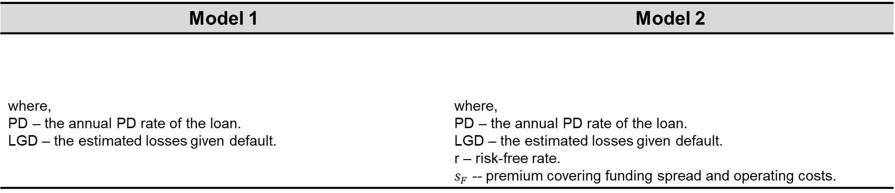
Credit risk-based pricing Credit risk-based pricing. Large homogeneous portfolio
Price of the expected credit risk
To cover the loan expected loss, the bank needs to apply a rate, equal to the risk-free rate (plus funding spread and operating costs) plus a spread, that makes the expected return on the loan equal to that of a risk-free investment of the same amount.
Model 1 | Model 2
where, PD – the annual PD rate of the loan. LGD – the estimated losses given default. | where, PD – the annual PD rate of the loan. LGD – the estimated losses given default. r – risk-free rate. $s_{F}$ -- premium covering funding spread and operating costs.
$$Credit spread=\frac{\left(1+r+s_{F}\right)×PD×LGD}{1−PD×LGD}$$
$$Credit spread=PD×LGD$$

Slide 27
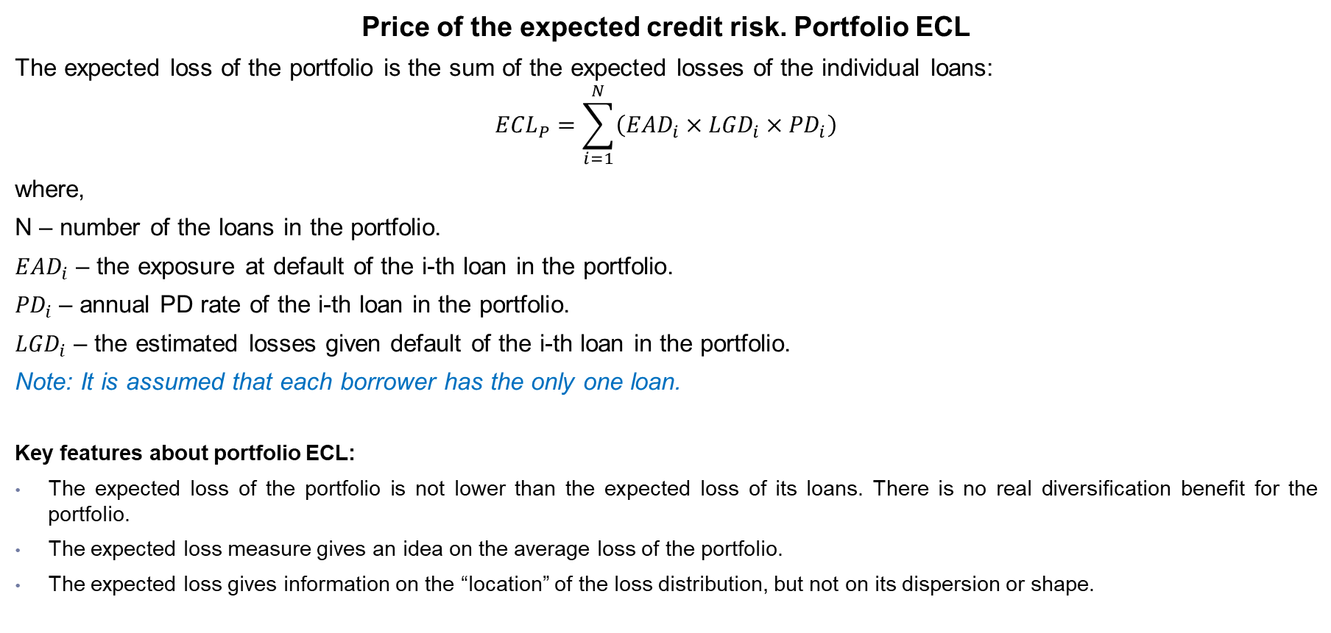
Credit risk-based pricing Credit risk-based pricing. Large homogeneous portfolio
Price of the expected credit risk. Portfolio ECL
The expected loss of the portfolio is the sum of the expected losses of the individual loans:
$${ECL}_{P}=\sum_{i=1}^{N}{\left({EAD}_{i}×{LGD}_{i}×{PD}_{i}\right)}$$
where,
N – number of the loans in the portfolio.
${EAD}_{i}$ – the exposure at default of the i-th loan in the portfolio.
${PD}_{i}$– annual PD rate of the i-th loan in the portfolio.
${LGD}_{i}$ – the estimated losses given default of the i-th loan in the portfolio.
Note: It is assumed that each borrower has the only one loan.
Key features about portfolio ECL:
The expected loss of the portfolio is not lower than the expected loss of its loans. There is no real diversification benefit for the portfolio.
The expected loss measure gives an idea on the average loss of the portfolio.
The expected loss gives information on the “location” of the loss distribution, but not on its dispersion or shape.

Slide 28
Credit risk-based pricing Credit risk-based pricing. Large homogeneous portfolio
Case study 7. Credit risk premium – Model 1.
Description: The credit rating system with 10 non-default grades was finally selected and has been recently approved by Model Sponsor. It is supposed that the credit grade system will be used for capital at credit risk assessment, as well as loan pricing. The Retail Lending Department has just received new credit rating system to build risk-based pricing model for retail loans. Miriam Pearson, junior product pricing analyst, has been asked to explore the best practice and propose the credit risk premium model.
Task: Imagine yourself in Miriam’s shoes and estimate credit risk premium based on Model 1. Identify advantages and model limitations. Make conclusion about business application and economic impact of the model if it would be implemented.
Solution:

Slide 29
Credit risk-based pricing Credit risk-based pricing. Large homogeneous portfolio
Case study 7. Credit risk premium – Model 1. (continue)
Description: The credit rating system with 10 non-default grades was finally selected and has been recently approved by Model Sponsor. It is supposed that the credit grade system will be used for capital at credit risk assessment, as well as loan pricing. The Retail Lending Department has just received new credit rating system to build risk-based pricing model for retail loans. Miriam Pearson, junior product pricing analyst, has been asked to explore the best practice and propose the credit risk premium model.
Task: Imagine yourself in Miriam’s shoes and estimate credit risk premium based on Model 1. Identify advantages and model limitations. Make conclusion about business application and economic impact of the model if it would be implemented.
Solution:

Slide 30
Credit risk-based pricing Credit risk-based pricing. Large homogeneous portfolio
Case study 8. Credit risk premium – Model 2.
Description: The conclusion about the credit risk premium Model 1 prepared by Miriam Pearson, junior product pricing analyst, has been considered by Head of Retail Product Pricing Department. Given the Model 1 does not fully cover expected credit losses, Miriam has been asked to explore alternative credit risk premium models.
Task: Help Miriam Pearson, junior product pricing analyst, to estimate credit risk premium using Model 2. Contrast and compare the model output with Model 1. Make conclusion about Model 2 business use and economic impact if it would be implemented.
Solution:

Slide 31
Credit risk-based pricing Credit risk-based pricing. Large homogeneous portfolio
Case study 8. Credit risk premium – Model 2. (continue)
Description: The conclusion about the credit risk premium Model 1 prepared by Miriam Pearson, junior product pricing analyst, has been considered by Head of Retail Product Pricing Department. Given the Model 1 does not fully cover expected credit losses, Miriam has been asked to explore alternative credit risk premium models.
Task: Help Miriam Pearson, junior product pricing analyst, to estimate credit risk premium using Model 2. Contrast and compare the model output with Model 1. Make conclusion about Model 2 business use and economic impact if it would be implemented.
Solution:

Slide 32
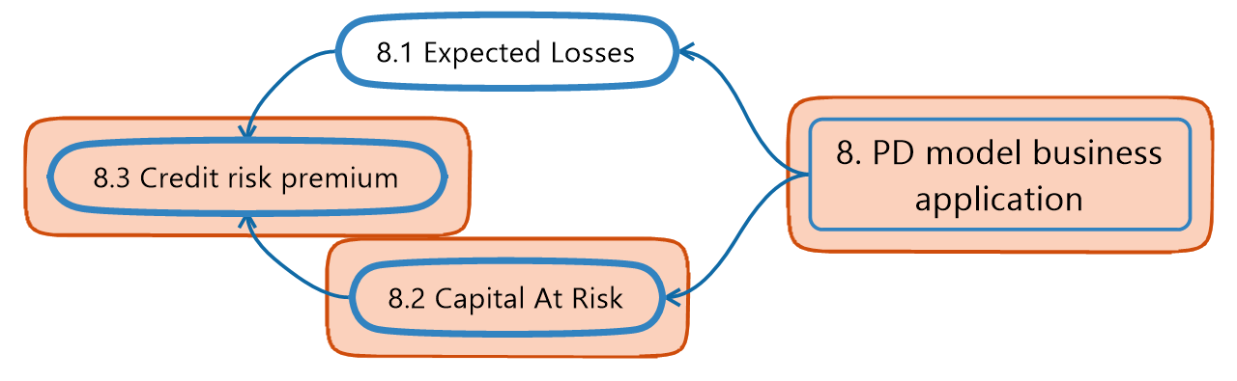
Credit risk-based pricing Credit risk-based pricing. Large homogeneous portfolio
Costs of economic capital at credit risk
Price of the economic capital at credit risk is a function of five factors:
The probability of default by the borrower (PD).
PD is summarized in the counterparty’s rating.
The loss given default (LGD).
LGD is a function of the type of loan and, in particular, of any collateral provided.
The economic capital (VaR) absorbed by the loan.
The bank’s required return on equity (costs of equity).
The risk-free rate plus funding spread and operating costs.
Note: The last two factors are independent from the characteristics of the borrower/loan, and depend on the general level of interest rates, the state of the capital markets, and the bank’s overall risk profile.

Slide 33
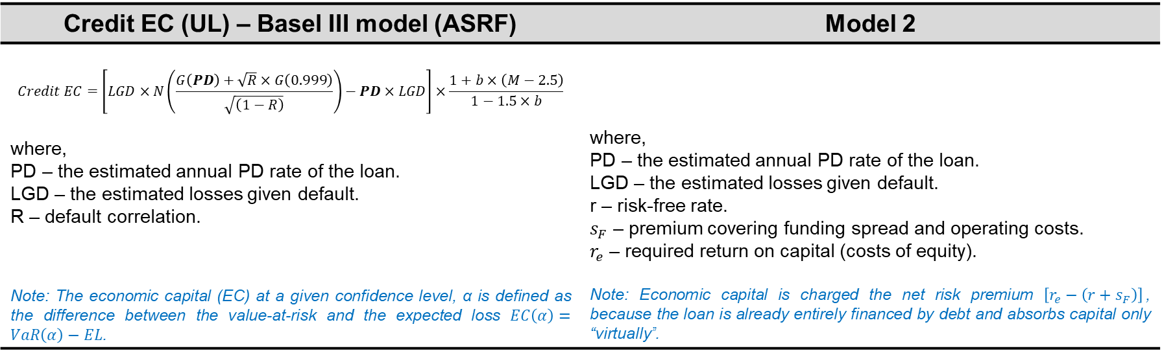

Credit risk-based pricing Credit risk-based pricing. Large homogeneous portfolio
Costs of economic capital at credit risk
Credit EC (UL) – Basel III model (ASRF) | Model 2
$$Credit EC=\left[LGD×N\left(\frac{G\left(PD\right)+\sqrt{R}×G\left(0.999\right)}{\sqrt{\left(1−R\right)}}\right)−PD×LGD\right]×\frac{1+b×\left(M−2.5\right)}{1−1.5×b}$$ where, PD – the estimated annual PD rate of the loan. LGD – the estimated losses given default. R – default correlation. Note: The economic capital (EC) at a given confidence level, α is defined as the difference between the value-at-risk and the expected loss $EC\left(α\right)=VaR\left(α\right)−EL$. | where, PD – the estimated annual PD rate of the loan. LGD – the estimated losses given default. r – risk-free rate. $s_{F}$ – premium covering funding spread and operating costs. $r_{e}$ – required return on capital (costs of equity). Note: Economic capital is charged the net risk premium $\left[r_{e}−\left(r+s_{F}\right)\right]$, because the loan is already entirely financed by debt and absorbs capital only “virtually”.
$$Costs of EC=\frac{Credit EC×\left[r_{e}−\left(r+s_{F}\right)\right]}{1−PD×LGD}$$
Wholesale borrowers only

Slide 34

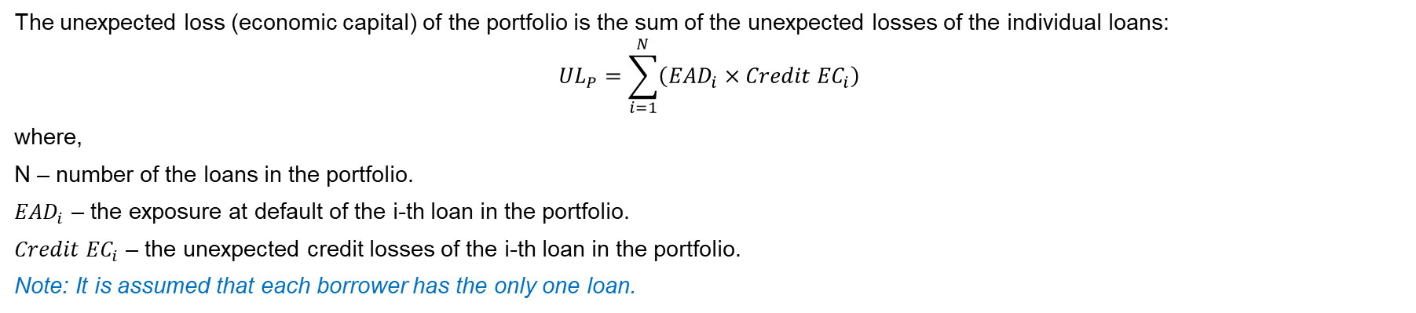
Credit risk-based pricing Credit risk-based pricing. Large homogeneous portfolio
Costs of economic capital at credit risk. Portfolio Credit EC
The Basel one-factor credit risk economic capital model is assumed to be portfolio invariant implying:
The number of loans in the bank’s portfolio goes to infinity, corresponding to an infinitely granular portfolio.
The idiosyncratic risks associated to each individual exposure cancel out and only the systematic risk determines the portfolio distribution and losses.
The capital required for any given loan depends only on the risk of that loan (PD, LGD and EAD) and does not depend on the portfolio to which the loan is added or belongs.
The unexpected loss (economic capital) of the portfolio is the sum of the unexpected losses of the individual loans:
$${UL}_{P}=\sum_{i=1}^{N}{\left({EAD}_{i}×{Credit EC}_{i}\right)}$$
where,
N – number of the loans in the portfolio.
${EAD}_{i}$ – the exposure at default of the i-th loan in the portfolio.
${Credit EC}_{i}$ – the unexpected credit losses of the i-th loan in the portfolio.
Note: It is assumed that each borrower has the only one loan.

Slide 35
Credit risk-based pricing Credit risk-based pricing. Large homogeneous portfolio
Case study 9. Costs of economic capital at credit risk – Model 2.
Description: The bank Alpha has dominating position in retail market given its technology advantage. Therefore, the Head of Retail Product Pricing Department considers to include the costs of economic capital into loan rate. The credit risk premium Model 2 showed a quite good performance in terms of expected credit loss coverage. As a result, Miriam Pearson, junior product pricing analyst, has proposed to leverage Model 2 for the costs of economic capital premium estimation purpose.
Task: Leverage and apply Model 2 to estimate the costs of economic capital premium. Summarize your observations and make conclusion about loan price impact if the costs of capital would be added.
Solution:
# | Loan ID | Client ID | Outstanding loan balance, USD | Residual maturity, years | PD | LGD | Funding and operating costs, % | ROE, % | Correlation, R | Credit EC, % | Costs of EC premium
1 | L-100001 | C-990001 | 1 000.00 | 1.00 | 10.00% | 60.00% | 5.00% | 10.00% | 0.03 | 8.06% | 0.43%
2 | L-100002 | C-990002 | 1 000.00 | 1.00 | 10.00% | 60.00% | 5.00% | 10.00% | 0.03 | 8.06% | 0.43%
3 | L-100003 | C-990003 | 1 000.00 | 1.00 | 10.00% | 60.00% | 5.00% | 10.00% | 0.03 | 8.06% | 0.43%
4 | L-100004 | C-990004 | 1 000.00 | 1.00 | 10.00% | 60.00% | 5.00% | 10.00% | 0.03 | 8.06% | 0.43%
5 | L-100005 | C-990005 | 1 000.00 | 1.00 | 10.00% | 60.00% | 5.00% | 10.00% | 0.03 | 8.06% | 0.43%
6 | L-100006 | C-990006 | 1 000.00 | 1.00 | 10.00% | 60.00% | 5.00% | 10.00% | 0.03 | 8.06% | 0.43%
7 | L-100007 | C-990007 | 1 000.00 | 1.00 | 10.00% | 60.00% | 5.00% | 10.00% | 0.03 | 8.06% | 0.43%
8 | L-100008 | C-990008 | 1 000.00 | 1.00 | 10.00% | 60.00% | 5.00% | 10.00% | 0.03 | 8.06% | 0.43%
9 | L-100009 | C-990009 | 1 000.00 | 1.00 | 10.00% | 60.00% | 5.00% | 10.00% | 0.03 | 8.06% | 0.43%
10 | L-100010 | C-990010 | 1 000.00 | 1.00 | 10.00% | 60.00% | 5.00% | 10.00% | 0.03 | 8.06% | 0.43%

Slide 36
Credit risk-based pricing Credit risk-based pricing. Large homogeneous portfolio
Mortgage loan (example of the offers in Poland)

Slide 37
Credit risk-based pricing Credit risk-based pricing. Large homogeneous portfolio
Case study 10. Credit risk premium: Banking product application
Description: The credit risk premium and the costs of economic capital Model 2 is deemed to be fit for loan pricing purposes. However, the Head of Retail Product Pricing Department is concerned about loan rate impact if the Model 2 would be applied towards expected retail borrowers. To address the aforementioned concerns, Miriam Pearson, junior product pricing analyst, has proposed to apply Model 2 towards existing loans and borrowers assessed based on recently approved credit rating system.
Task: Using Model 2 calculate credit risk premium, the costs of economic capital premium and total loan rate for the representative sample of existing borrowers. Summarize your observations regarding loan price structure.
Solution:

Slide 38
Credit risk-based pricing Credit risk-based pricing. Large homogeneous portfolio
Case study 10. Credit risk premium: Banking product application. (continue)
Description: The credit risk premium and the costs of economic capital Model 2 is deemed to be fit for loan pricing purposes. However, the Head of Retail Product Pricing Department is concerned about loan rate impact if the Model 2 would be applied towards expected retail borrowers. To address the aforementioned concerns, Miriam Pearson, junior product pricing analyst, has proposed to apply Model 2 towards existing loans and borrowers assessed based on recently approved credit rating system.
Task: Using Model 2 calculate credit risk premium, the costs of economic capital premium and total loan rate for the representative sample of existing borrowers. Summarize your observations regarding loan price structure.
Solution:

Slide 39
4. Risk-adjusted return on capital (RAROC)

Slide 40
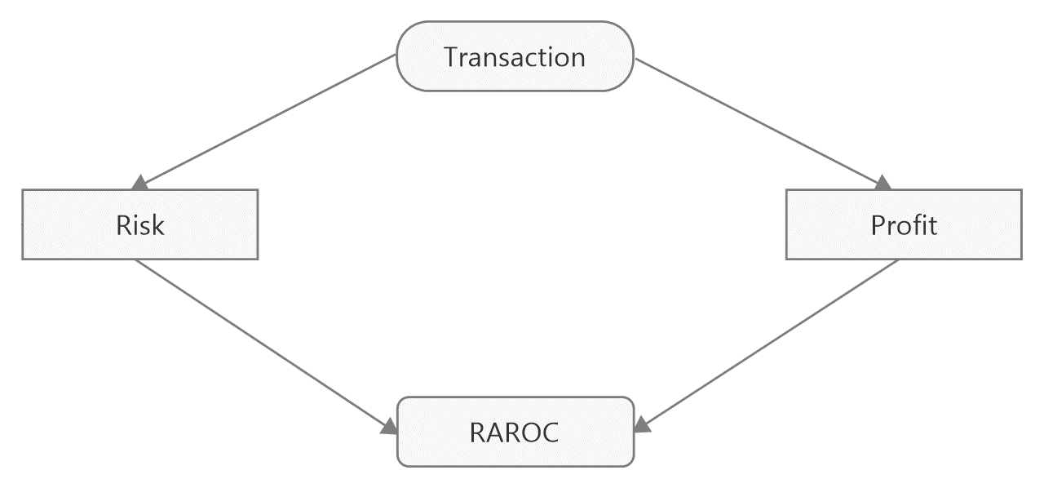
Credit risk-based pricing Risk-adjusted return on capital (RAROC)
Using Risk-Adjusted Performance to Make Business Decisions
Risk-adjusted performance can be used to support the following business decisions:
At the product level, to decide which products are profitable and how products must be priced to ensure that they are profitable.
At the relationship level, to show which customer relationships are profitable.
At the transaction level, to decide whether to enter into a transaction, and if so, at what price.
At the individual or group level, to compensate staff based on the profit they generate compared with the amount of the bank’s capital they consume.
At the business-unit level, to decide which units are adding the greatest profit relative to the risks they are taking.

Slide 41

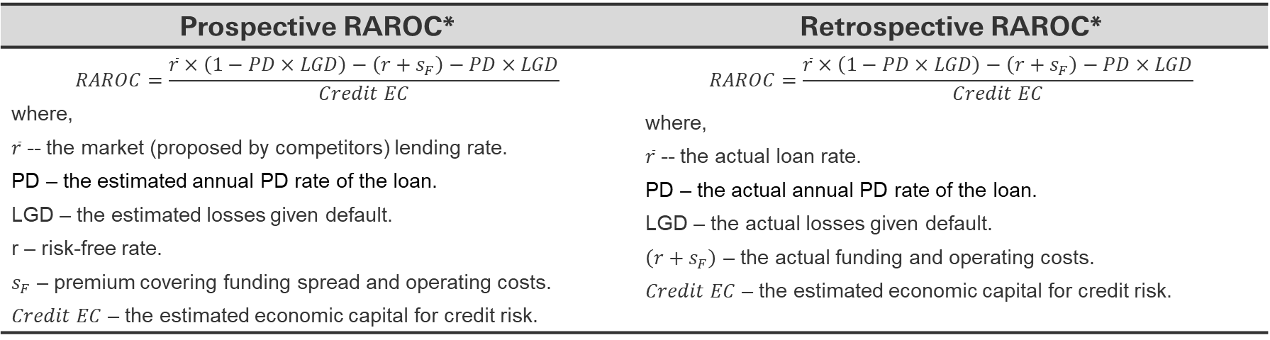
Credit risk-based pricing Risk-adjusted return on capital (RAROC)
RAROC is the expected net risk-adjusted profit divided by the economic capital that is required to support the transaction:
$$RAROC=\frac{Risk−adjusted net income}{Econimic Capital}$$
Note: The risk-adjusted net income equals the revenues minus costs and the expected loss.
*RAROC is expressed as the premium over risk-free rate (in fact over funding and operating costs) on capital absorbed by the risks (unexpected losses) associated with the loan.
Prospective RAROC* | Retrospective RAROC*
$$RAROC=\frac{\overline{r}×\left(1−PD×LGD\right)−\left(r+s_{F}\right)−PD×LGD}{Credit EC}$$ where, $\overline{r}$ -- the market (proposed by competitors) lending rate. PD – the estimated annual PD rate of the loan. LGD – the estimated losses given default. r – risk-free rate. $s_{F}$ – premium covering funding spread and operating costs. $Credit EC$ – the estimated economic capital for credit risk. | $$RAROC=\frac{\overline{r}×\left(1−PD×LGD\right)−\left(r+s_{F}\right)−PD×LGD}{Credit EC}$$ where, $\overline{r}$ -- the actual loan rate. PD – the actual annual PD rate of the loan. LGD – the actual losses given default. $\left(r+s_{F}\right)$ – the actual funding and operating costs. $Credit EC$ – the estimated economic capital for credit risk.

Slide 42

Credit risk-based pricing Risk-adjusted return on capital (RAROC)
RAROC. Business application
Should we enter into a transaction/product or keep running business?
It would destroy value for the bank.
No
RAROC>=$r_{e}−\left(r+s_{f}\right)$
No
Is there the potential for cross-selling to earn more?
No
Can we get a new customer (or retain the current one) creating the value for the bank?
Yes
Yes
Yes
It would create value for the bank.

Slide 43
Credit risk-based pricing Risk-adjusted return on capital (RAROC)
Case study 11. RAROC.
Description: Two years later. The bank Alpha is no longer dominating bank in retail segment as the international banking groups have entered the local market. The retail business of the bank Alpha is operating under liquidity constraints and portfolio limits. Jack Peterson, credit analyst, has just received ten loan applications and applicants’ details from the loan officer. He is going to conduct credit analysis and make a recommendation to proceed or not with the loans given existing limits.
Task: Given that Jack can make only five positive recommendations to proceed with loan, identify the loans, which would create value for the bank. Justify your choice.
Solution:
# | Loan ID | Client ID | Outstanding loan balance, USD | Residual maturity, years | PD | LGD | Funding and operating costs, % | Correlation, R | Credit EC, % | ROE, % | Market loan rate, % | RAROC, %
1 | L-100001 | C-990001 | 1 000.00 | 1.00 | 10.11% | 60.00% | 5.00% | 0.03 | 8.09% | 15.00% | 7.50% | -49.70%
2 | L-100002 | C-990002 | 1 000.00 | 1.00 | 3.52% | 60.00% | 5.00% | 0.07 | 6.84% | 15.00% | 7.50% | 3.39%
3 | L-100003 | C-990003 | 1 000.00 | 1.00 | 2.50% | 60.00% | 5.00% | 0.08 | 6.50% | 15.00% | 7.50% | 13.65%
4 | L-100004 | C-990004 | 1 000.00 | 1.00 | 6.12% | 60.00% | 5.00% | 0.05 | 7.24% | 15.00% | 7.50% | -19.98%
5 | L-100005 | C-990005 | 1 000.00 | 1.00 | 6.12% | 60.00% | 5.00% | 0.05 | 7.24% | 15.00% | 7.50% | -19.98%
6 | L-100006 | C-990006 | 1 000.00 | 1.00 | 2.50% | 60.00% | 5.00% | 0.08 | 6.50% | 15.00% | 7.50% | 13.65%
7 | L-100007 | C-990007 | 1 000.00 | 1.00 | 6.12% | 60.00% | 5.00% | 0.05 | 7.24% | 15.00% | 7.50% | -19.98%
8 | L-100008 | C-990008 | 1 000.00 | 1.00 | 55.06% | 60.00% | 5.00% | 0.03 | 11.93% | 15.00% | 7.50% | -276.81%
9 | L-100009 | C-990009 | 1 000.00 | 1.00 | 3.52% | 60.00% | 5.00% | 0.07 | 6.84% | 15.00% | 7.50% | 3.39%
10 | L-100010 | C-990010 | 1 000.00 | 1.00 | 10.11% | 60.00% | 5.00% | 0.03 | 8.09% | 15.00% | 7.50% | -49.70%

Slide 44
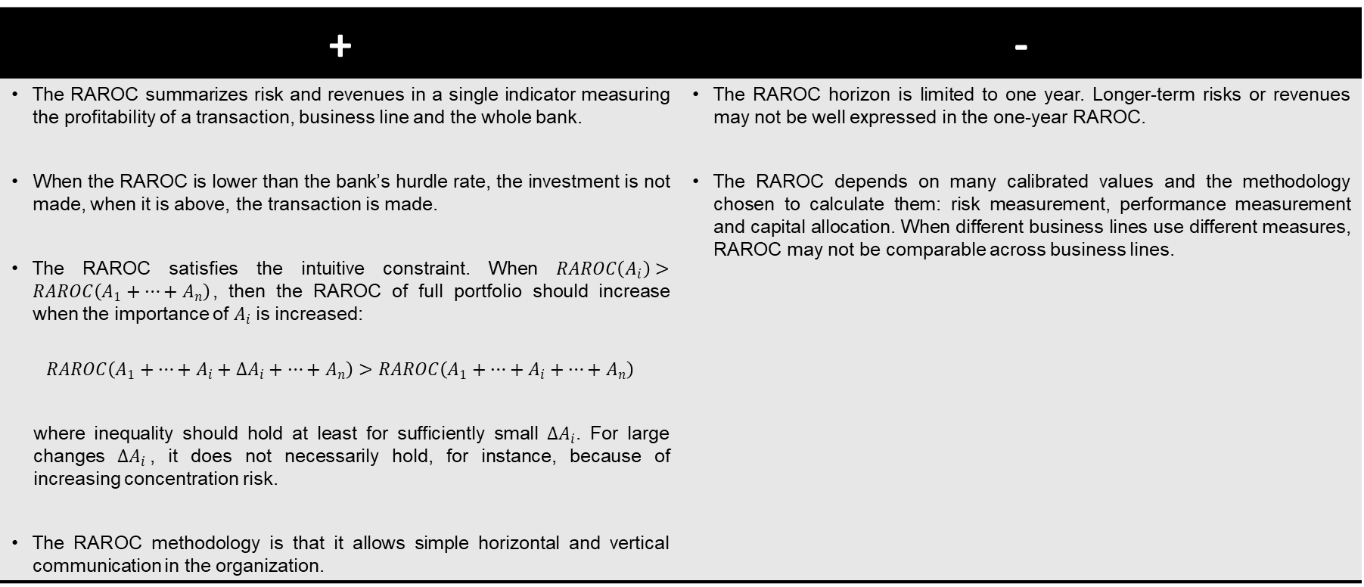
Credit risk-based pricing Risk-adjusted return on capital (RAROC)
RAROC. Summary
+ | -
The RAROC summarizes risk and revenues in a single indicator measuring the profitability of a transaction, business line and the whole bank. When the RAROC is lower than the bank’s hurdle rate, the investment is not made, when it is above, the transaction is made. The RAROC satisfies the intuitive constraint. When $RAROC\left(A_{i}\right)>RAROC\left(A_{1}+…+A_{n}\right)$, then the RAROC of full portfolio should increase when the importance of $A_{i}$is increased: $$RAROC\left(A_{1}+…+A_{i}+∆A_{i}+…+A_{n}\right)>RAROC\left(A_{1}+…+A_{i}+…+A_{n}\right)$$ where inequality should hold at least for sufficiently small $∆A_{i}$. For large changes $∆A_{i}$, it does not necessarily hold, for instance, because of increasing concentration risk. The RAROC methodology is that it allows simple horizontal and vertical communication in the organization. | The RAROC horizon is limited to one year. Longer-term risks or revenues may not be well expressed in the one-year RAROC. The RAROC depends on many calibrated values and the methodology chosen to calculate them: risk measurement, performance measurement and capital allocation. When different business lines use different measures, RAROC may not be comparable across business lines.

Slide 45
5. Conclusion: Model Validation

Slide 46
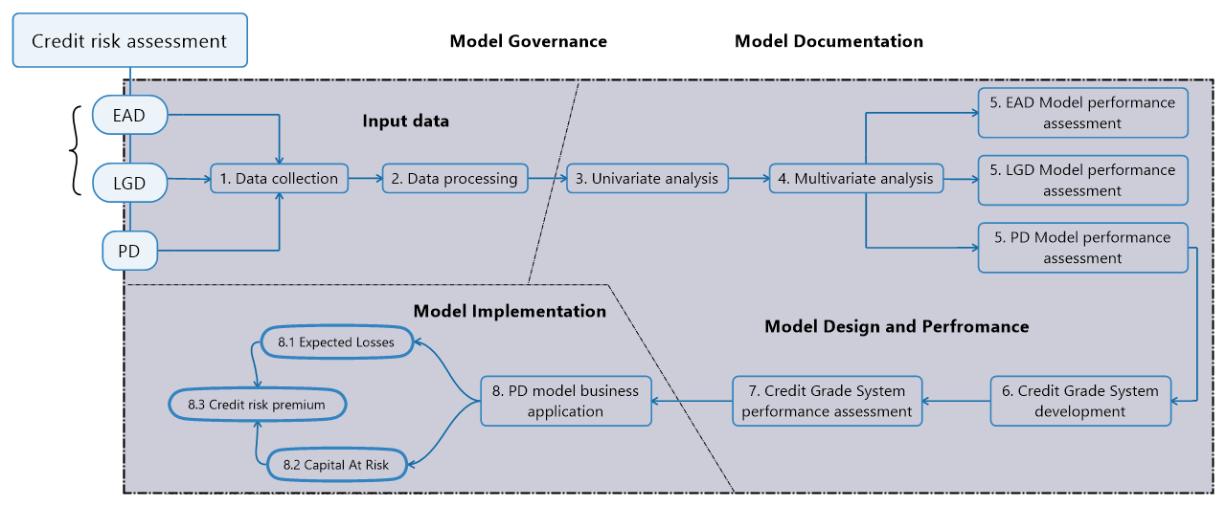
Credit risk-based pricing Credit Risk pricing: Model Validation
The Pareto principle (80/20 rule) states that, for many events, roughly 80% of the effects come from 20% of the causes.
For Model Validation the Pareto principle states that roughly 80% of the adverse impact is coming from the things being checked with 20% of the model validation time; and 80% of the model validation time is spent to validate the 20%-impact things.

Slide 47

Credit risk-based pricing Credit Risk pricing: Model Validation
Validation is fundamentally about:
the assessing the predictive ability of a bank’s risk estimates;
the use of ratings in the credit process.
Each kind of misjudgment of the creditworthiness harms an optimal capital allocation, a good pricing system, and, in consequence, the maximization of profits.
In the long run, banks (and/ or Fintech companies) with the most accurate rating system will prevail at the credit market!

Slide 48
Disclaimer
This presentation has been prepared by HSBC Service Delivery (Polska) Sp. z o.o. with a registered office located at Kapelanka 42A, 30-347 Kraków, Poland, registered in the District Court for Kraków-Śródmieście in Kraków, XI Commercial Division of the National Court Register, under the number KRS 0000310459, share capital (entirely paid) in the amount of 67 689 500,00 PLN, NIP 525-242-91-07, hereinafter referred to as “HSBC”.
HSBC has based this document on information obtained from sources it believes to be reliable but which has not been independently verified. While this information has been prepared in good faith, no representation or warranty, express or implied, is or will be made and no responsibility or liability is or will be accepted by the HSBC, or by any of their respective officers, employees or agents in relation to the accuracy or completeness of the Documents or any other written or oral information made available to any interested party or its advisers and any such liability is expressly disclaimed. Any charts and graphs included are from publicly available sources or proprietary data. No liability is accepted whatsoever for any direct, indirect or consequential loss arising from the use of this document. HSBC is under no obligation to keep current the information in this document. You are solely responsible for making your own independent appraisal of and investigations into the data, products, financial instruments and transactions referred to in this document and you should not rely on any information in this document as constituting investment advice. Neither HSBC nor any of its affiliates are responsible for providing you with legal, tax or other specialist advice and you should make your own arrangements in respect of this accordingly. The issuance of and details contained in this document, which is not for public circulation, does not constitute an offer or solicitation for, or advice that you should enter into, the purchase or sale of any security, commodity or other financial instrument or master agreement, or any other contract, agreement or structure whatsoever. This document is intended to be distributed in its entirety. Reproduction of this document, in whole or in part, or disclosure of any of its contents, without prior consent of HSBC or any associate, is prohibited.

Slide 49
Thank you!

